Slide 1
English Academic Writing Course
Unit 9 Referencing

Slide 2
Objectives
- Get to know the significance of referencing
- Understand the distinction between different styles of referencing

Slide 3
Task 1
Group Discussion:
1) Why do we need to reference and when do we do it?
2) How do we usually reference?
3) How many referencing styles do you know?
4) How do we create a reference list?

Slide 4
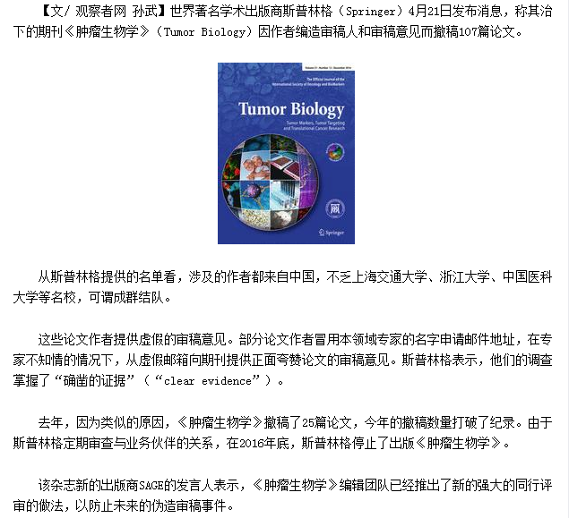
No plagiarism, no cheating!

Slide 5
When should you reference?
When you:
Quote the author’s exact words
Copy the author’s tables, figures and/or diagrams
Paraphrase an author’s ideas
Summarise the author’s ideas

Slide 6
Why should you reference in your work?
avoids plagiarism and the subsequent failing of the assessment and/or unit lends credibility to your view in that citing other works substantiates your own line of argument;
gives recognition to authors/sources whose arguments/empirical research you have used;

Slide 7
allows readers to locate the articles, texts and electronic sources you have used in your writing;
demonstrates to the reader the breadth of your research, that is, the range of sources you have used;

Slide 8
demonstrates how up-to-date your research is;
demonstrates the depth of the research i.e. how effectively you have utilised the extant literature in a particular field or discipline.
c

Slide 9
But ... how?

Slide 10
Task 2
Read passage 1: IEEE( The Institute of Electrical and Electronics Engineers) Reference Style.
Tips: Teachers guide students to read and analyze different items for a better understanding.

Slide 11
Task 3
Read passage 2: MLA (Modern Language Association) Reference Style.
Tips: Teachers guide students to read and analyze different items for a better understanding.

Slide 12
Task 4
Complete Exercise 1.3 to find out the differences between IEEE and MLA styles.
Purpose:
Through this task, more subtle differences can be highlighted to gain a better understanding of the two styles.

Slide 13
Task 5
6. Language focus:
Complete exercises 2.1 & 2.2 on page 129 with the knowledge learned to better understand the two styles.
(20 minutes)

Slide 14
Supplementary: The APA Style
Using the APA style(commonly referred to as the American Psychological Association method of citation) or Harvard style:
show the last name/s of the author (or authors)
include the year of publication

Slide 15
cite the author names in the order in which they appear in the source
within the brackets use “&”, but in the text use “and” (e.g. see three-five authors below)
indicate page number (if it is a direct quotation, statistics, a table or diagram)

Slide 16
Deegan (2002) suggests there are numerous methods which may be adopted. OR
Few authors have approached the topic in this way (Deegan, 2002).

Slide 17
Multiple References
One author:
…the results were inconclusive
(Hawkins, 2003).
Hawkins (2003) reported that the results
were inconclusive.

Slide 18
Two authors:
Consideration of expatriate adjustment is becoming increasingly important (Mahoney &Trigg, 2001; Stone, 2002).
…(Bovey & Hede, 2001)
Bovey and Hede (2001) argue...

Slide 19
Three or more authors:
…(Clegg, Hardy & Nord, 1996)
Clegg, Hardy and Nord (1996) assert that...
Thereafter, type only the first author name, then “et al.” …(Clegg et al., 1996)
Clegg et al. (1996) assert that....

Slide 20
Multiple works by the same author cited at the same time
Enter the years of publication in date order
…(Jones, 2000, 2001)
Jones (2000, 2001) applies the same principles to…

Slide 21
Multiple works by the same author in the same year
Differentiate the citations by adding an a,b,c…suffix to the year
The first entry receives the suffix “a”, the next “b”, etc.
…(Brown, 1998a, 1998b)
Brown (1998a)… later in the text… Brown (1 998b)

Slide 22
An organisation as the author
(Reserve Bank of Australia, 2007)
If the organisation has a well recognised abbreviation, it can be cited as follows:
First time cited… (International Monetary Fund [IMF], 1997) Subsequently… (IMF, 1997)

Slide 23
Multiple references
List alphabetically, separated by semi-colons:
There is considerable support for this view (Allen, 2001; Bryson & Lodge, 1999; Wong, 2003).

Slide 24
Direct quotation:
In addition to author name and year the page number must be stated.
“The key to understanding microeconomics is to realise that its overwhelming focus is on the role of prices” (Gittins, 2006, p. 8).

Slide 25
Gittins (2006) suggests that “the key to understanding microeconomics is to realise that its overwhelming focus is on the role of prices” (p. 8).

Slide 26
Citing a secondary source
For example, you read a 2006 article by Friedman in which he refers to an article by Chang, published in 1997.
To cite Chang in your writing, the following formats apply:
…(Chang, 1997, as cited in Friedman, 2006).
Chang (1997, as cited in Friedman, 2006) suggests that this is inconsistent…
Friedman (2006) cited Chang (1997) as arguing for…

Slide 27
Books
General format:
Author surname, Author initial(s). (Year of publication). Title of book (edition number if not the 1st edition). Place of publication: Name of publisher.

Slide 28
Gittins, R. (2006). Gittins’ guide to economics. Crows Nest, NSW: Allen & Unwin.
Luthans, F. (2002). Organisational behavior (9th ed.). Boston: McGraw-Hill Irwin.
Mahoney, D. &Trigg, M. (2001). International business: A managerial perspective (2nd ed.). Sydney: Pearson Education.

Slide 29
If there are more than six authors, after the sixth author type “et al.” and omit the subsequent names
Mussen, P., Rosenzweig, M. R., Aronson, E., Elkind, D., Feshbach, S., Geiwitz, P. J., et al. (1973). Psychology: An introduction. Lexington, MA: Heath.

Slide 30
Edited book
Follows the book format, with the editor’s name followed by (Ed.), or (Eds.) if more than one editor
Clegg, S. R., Hardy, C., & Nord, W. R. (Eds.). (1996). Handbook of organisation studies. London: Sage Publications.
c

Slide 31
Journal article
General format:
Author family name, Author initial(s). (Year of publication). Title of the article. Title of the Journal, volume number (issue number), page numbers of the article.
Milner, L. M. & Fodness, D. (1996). Product gender perceptions: The case of China. International Marketing Review, 13(4), 40-51.

Slide 32
Magazine
If there is a volume number, it follows the magazine title, in italics. In the example below, 159 is the volume number, and the page number is 46.
MacLeod, S. (2002, April 8). An olive branch or stick? Time, 159, 46.
Guilliat, S. (2005, March 26). Leap of faith. Good Weekend: The Age Magazine, 24-31.

Slide 33
Newspaper article – print and microfiche
Precede the page number with “p.” or if more than one page, “pp.” (For an article starting on page 1, then continuing and ending on page 3, the format would be pp. 1, 3.)
Hopkins, P. (2004, January 7). Parmalat cooked the books worldwide: Police. The Age, p. 2.

Slide 34
Reports from organisations
Sumitomo Mitsui Banking Corporation.
(2001). Annual report 2001. Tokyo: Author.
Department of Industry Science and Technology. (2004). Australian business innovation: A strategic analysis. Canberra: Australian Government Publishing Service.

Slide 35
Electronic journal article – from a free journal on the Web
Ciocchetti, C. A. (2001). Monitoring employee e-mail: Efficient workplaces vs employee privacy. Duke Law & Technology Review, 0026. Retrieved from http://www.law.duke.edu/journals/dltr/articles/2001dltr0026.html

Slide 36
Electronic newspaper article – from the Web, open access
Kaneko, M. (2007, October 16). Investment funds focused on ‘womenomics’ gaining attention. The Japan Times Online.
Retrieved from http://search.japantimes.co.jp/cgibin/nb20071016a3.html

Slide 37
Company profile – from a Monash database (e.g. Business Source Premier)
Datamonitor. (2007, July 27). Air France KLM: Company profile. Retrieved from Business Source Premier database.

Slide 38
Industry report – from a Monash database (e.g. IBISWorld)
IBISWorld. (2007, August 29). Biscuit manufacturing in Australia (C21 63). Retrieved from IBISWorld database.

Slide 39
Electronic book – from a Monash
e-book database (e.g. Ebook Library)
Lowe, B. (2007). Business-to-business
marketing practices in China. Available
from Ebook Library database.

Slide 40
Conference paper – on the Web
Kajewski, M. (2006). Emerging technologies changing our service delivery model.
Click06: ALIA 2006 Biennial Conference. Retrieved from Australian Library and Information Association Web site: http://conferences.alia.org.au/alia2006/Papers/Mary_Ann_Kajewski.pdf

Slide 41
Annual report – from an organisation Website
In the following example, as the author is also the publisher, it is not necessary to include the publisher name after “Retrieved from”
Ford Motor Company. (2007). Fast forward: 2006 annual report. Retrieved from http://www.ford.com/doc/2006_AR.pdf

Slide 42
Government report – on the Web
Department of Health and Aging. (2000). National medicines policy. Retrieved from http://www.health.gov.au/internet/main/publishing.nsf/Content/1184A3544D5E9364CA2574FC0079DC1A/$File/nmp2000.pdf

Slide 43
文献管理软件endnote X6可以提供给学生下载安装：https://pan.baidu.com/s/1l84mEl8aoEa_f0ocMhFJtQ
endnote导入文献及其它相关操作可见附件内的使用手册。

